Slide 1
Group Design Practical
The Mouse Story Game

Slide 2
The Team:
George Andrews
Adam Morris
Teodora Musatoiu
Bozhidar Vasilev
Tamio-Vesa Nakajima
Sophie Windsor

Slide 3

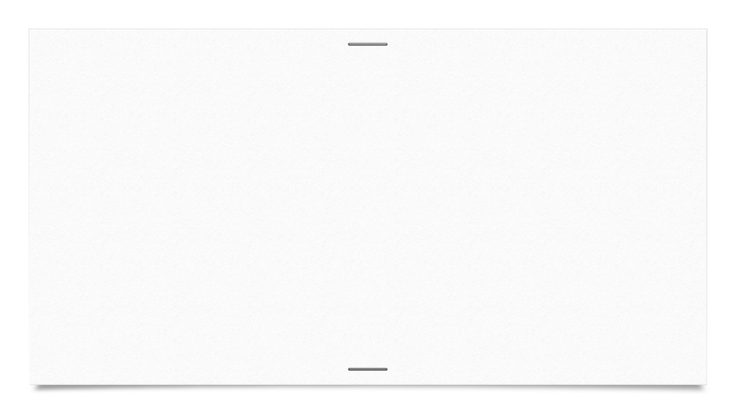


The Task: “Finding Technical Talent”
Look for ways to attract new technical talent.
Game or puzzle running in a web browser
Goals:
Get students interested in applying
Flag good-looking candidates
Sponsor: Metaswitch

Slide 4
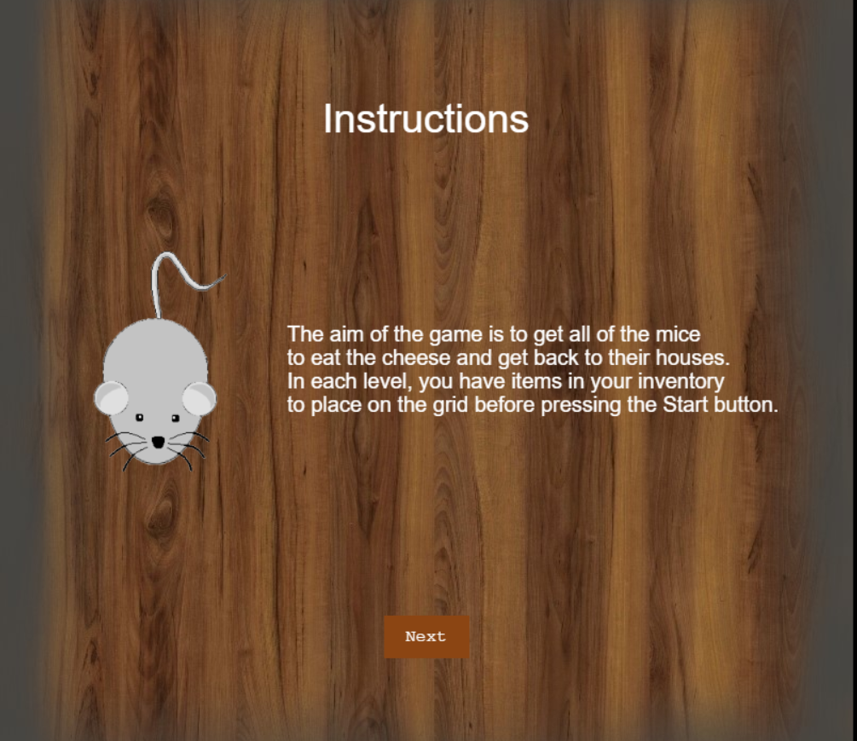
The idea: The Mouse Story
Get all of the mice to eat the cheese.
Use the list of items in the inventory to direct them to their houses
Once ready, press start to see the results of your strategy.

Slide 5

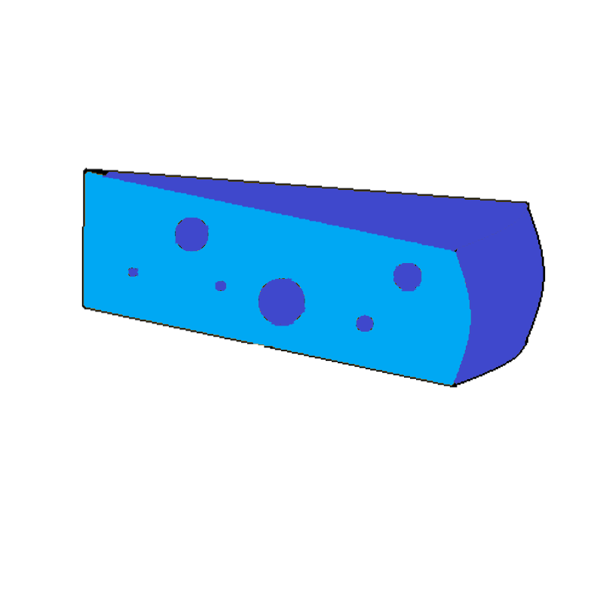



Available Items:
Obstacles
Cheese which needs to be eaten by mice
Houses which attract the mice

Slide 6
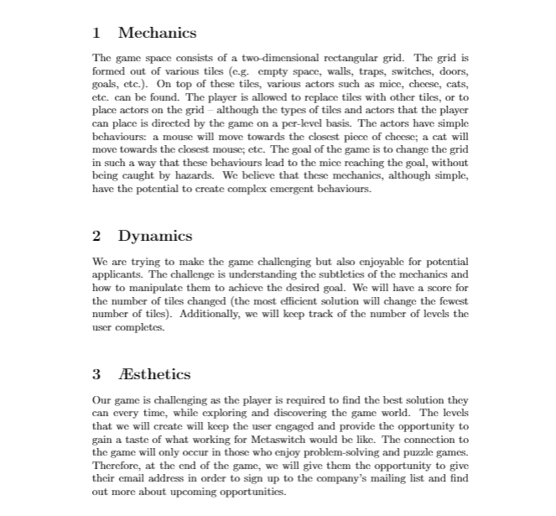
Specification:
Mechanics
Dynamics
Aesthetics

Slide 7
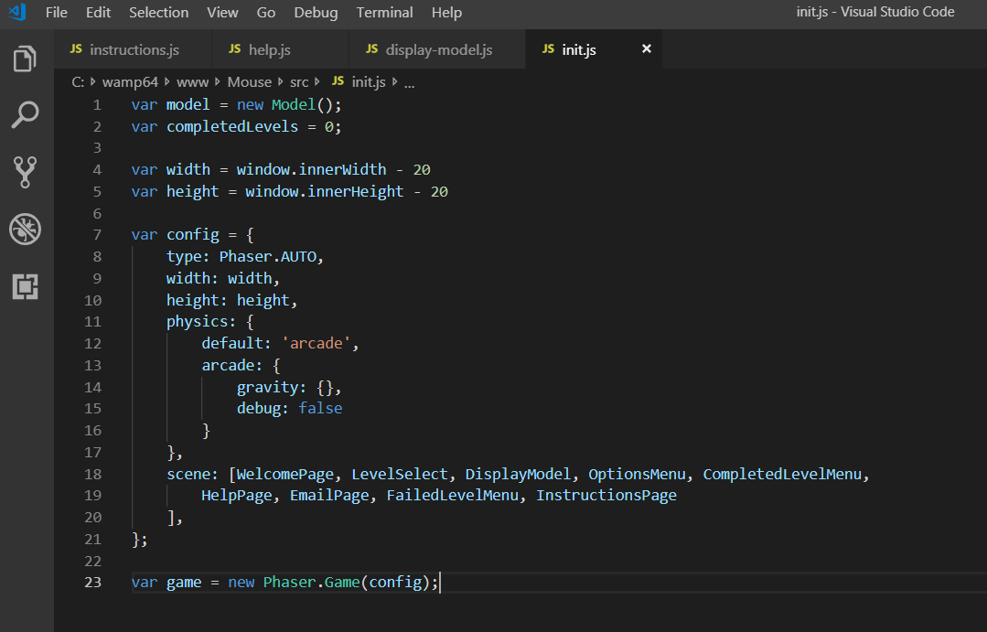
Implementation:
Wamp → local web server
Phaser → game framework
Java Script → programming language
Browser Cookies

Slide 8
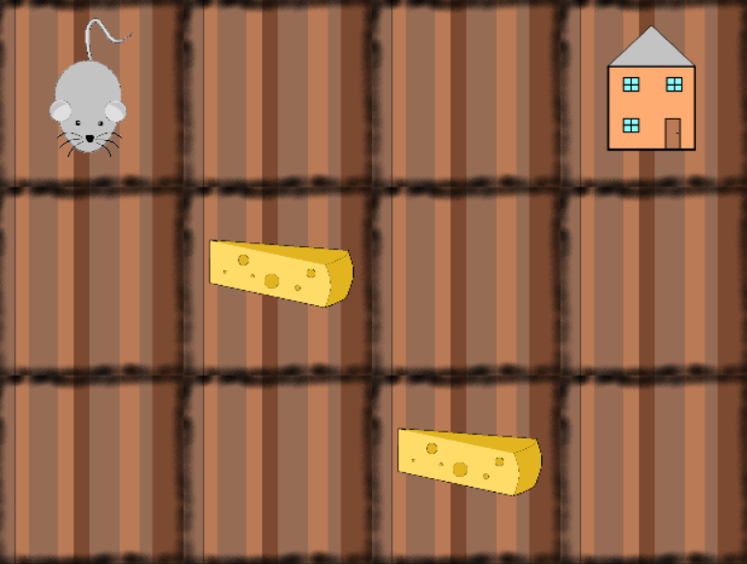
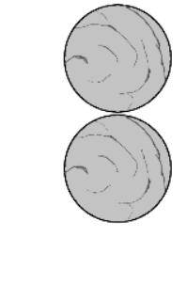
A few levels:

Slide 9
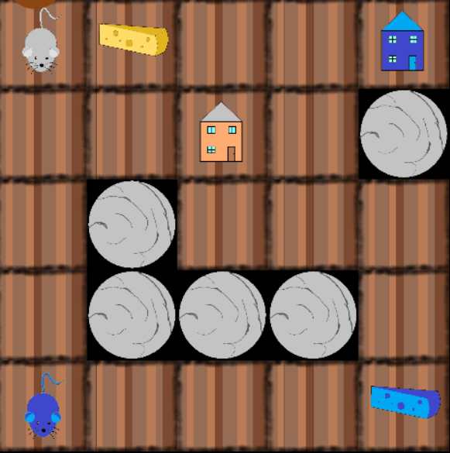
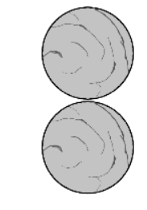
A few levels:

Slide 10

Thank you!

